Slide 1
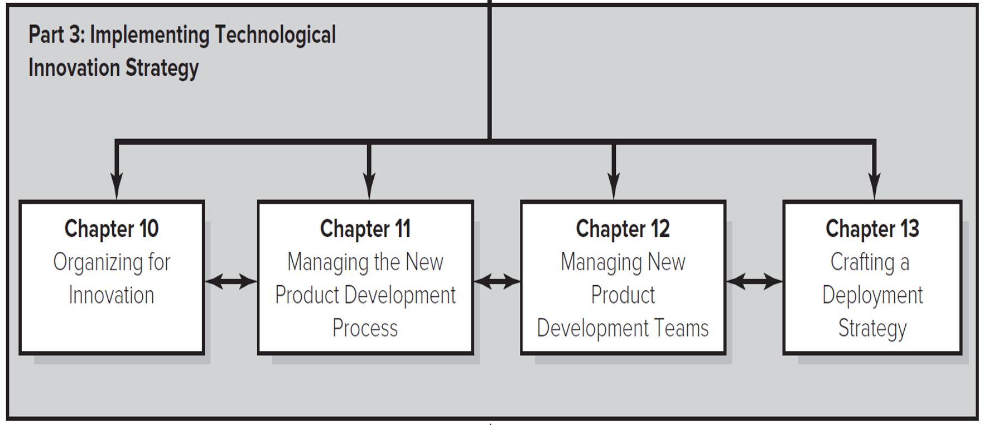
Course Overview: Part 3
Part Three: Implementing Technological Innovation Strategy.
Organizing for innovation.
Managing the new product development process.
Managing new product development teams.
Crafting a deployment strategy.
Access the text alternative for these images

Slide 2
Organizing for Innovation

Slide 3
The question posed
Organizational structure and its use of rules, standardized procedures and controls can have a bearing on an organization’s ability to generate innovation.
Small, flexible structures are thought to be best suited to idea generation and structures with well-developed procedures and standards may engender better investment decisions and more efficient implementation.

Slide 4
Size and Structural Dimensions of the Firm
Size: Is Bigger Better?
In 1940s, Schumpeter argued that large firms would be more effective innovators.
Better able to obtain financing.
Better able to spread costs of R&D over large volume.
Large size may also enable…
Greater economies of scale and learning effects.
Taking on large scale or risky projects.

Slide 5
Size and Structural Dimensions of the Firm
However, large firms might also be disadvantaged at innovation because…
R&D efficiency might decrease due to loss of managerial control.
Large firms have more bureaucratic inertia.
More strategic commitments tie firm to current technologies.
Strategic commitments to customers and suppliers can lead to the “Icarus Paradox”; where success in existing lines of business or products can lead to overconfidence, carelessness and reluctance to question the status quo.

Slide 6
Xerox and the Icarus Paradox.
In Greek mythology, Icarus was so enthralled with his exceptional wax wings that he flew close to the sun, melting his wings and crashing to his death.
Icarus Paradox:
That which you excel at can be your undoing.
Similarly, in 19 60s and 70s, Xerox had such a stranglehold on the photocopier market, it did not pay attention to new Japanese competitors making inexpensive copiers.
By the mid-19 70s, Xerox was losing market share to the Japanese at an alarming rate and had to engage in a major restructuring and turnaround.

Slide 7
Size and Structural Dimensions of the Firm
Small firms, are often more flexible and entrepreneurial because they do not have the burden of a large bureaucracy or large investments in fixed assets.
These firms often have shorter development cycles and a sharper focus because they have much more limited resources than larger firms.
→ Many big firms have found ways of “feeling small”.
Break overall firm into several subunits.
Can utilize different culture and controls in different units.

Slide 8
Size and Structural Dimensions of the Firm
The firm’s ability to be an effective innovator is influenced by the degree to which its structure is
formalized,
(2) standardized
(3) centralized

Slide 9
Size and Structural Dimensions of the Firm
Formalization: The degree to which the firm utilizes rules and procedures to structure the behavior of employees.
Can substitute for managerial oversight but can also make firm rigid.
Standardization: The degree to which activities are performed in a uniform manner.
Facilitates smooth and reliable outcomes but can stifle innovation.
https://www.youtube.com/watch?v=vNfy_AHG-MU&list=PLc6EeKrKYKClN48ow3Irj_sO0zQEY-Vwu&index=76
https://www.youtube.com/watch?v=ZdvEGPt4s0Y&list=PLc6EeKrKYKClN48ow3Irj_sO0zQEY-Vwu&index=78

Slide 10
Size and Structural Dimensions of the Firm
Centralization: The degree to which decision-making authority is kept at top levels of the firm OR the degree to which activities are performed at a central location.
Centralized authority ensures projects match firm-wide objectives and may be better at making bold changes in overall direction.
Centralized activities avoid redundancy, maximize economies of scale, and facilitate firm-wide deployment of innovations.

Slide 11
Size and Structural Dimensions of the Firm
But centralized authority and activities might not tap diverse skills and resources, and projects may not closely fit needs of divisions or markets.
Some firms have both centralized and decentralized R&D activities.

Slide 12
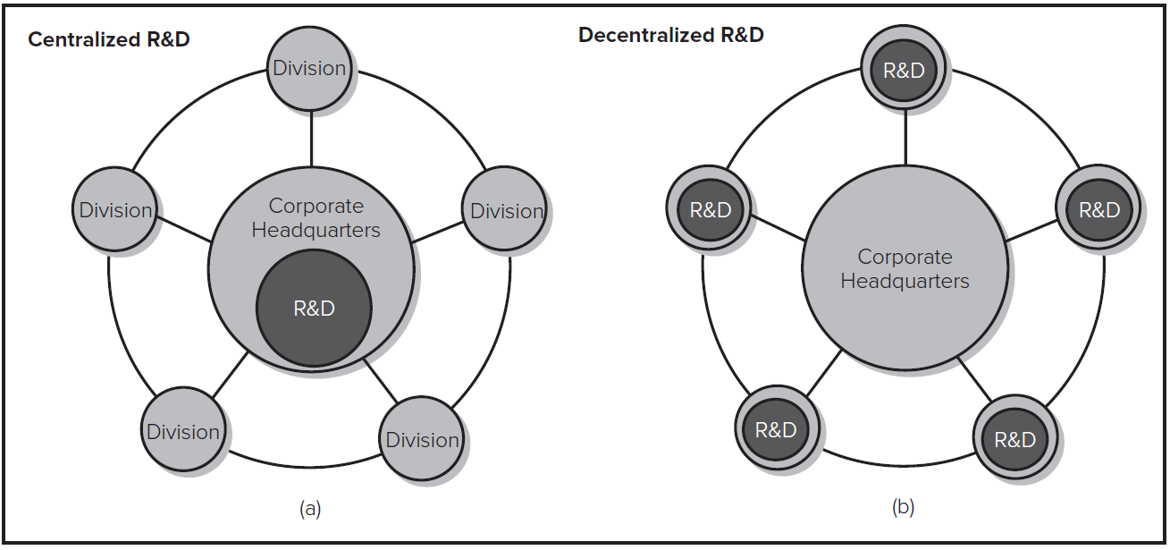
Size and Structural Dimensions of the Firm
Centralized and Decentralized R&D Activities
Access the text alternative for these images

Slide 13
Mechanistic versus Organic Structures
Mechanistic Structures have high formalization and standardization.
Good for operational efficiency, reliability.
Minimizes variation → may stifle creativity.
Organic structures have low formalization and standardization; described as “free flowing”.
Encourages creativity and experimentation.
May yield low consistency and reliability in manufacturing.

Slide 14
Size versus Structure
Many advantages and disadvantages of firm size are actually due to structural dimensions of formalization, standardization, and centralization.
Large firms typically make greater use of formalization and standardization
BUT …..

Slide 15
Size versus Structure
The Ambidextrous Organization
The Best of Both Worlds?
Some divisions (for example, R&D, new product lines) may be small and organic; others larger and mechanistic.
Can also alternate through different structures over time.

Slide 16
Skunk works
Skunk works that suggests that R&D teams may need to be isolated from the rest of the organization in order to explore new alternatives, unfettered by the demands of the rest of the organization.
Example: Steve jobs with the small team working at the project Macintosh
https://www.youtube.com/watch?v=2B-XwPjn9YY&list=PLc6EeKrKYKClN48ow3Irj_sO0zQEY-Vwu&index=79
https://www.youtube.com/watch?v=Tuw8hxrFBH8&list=PLc6EeKrKYKClN48ow3Irj_sO0zQEY-Vwu&index=81

Slide 17
Modularity and loosely coupled organizations
Firms can try to find a balance between efficiency and flexibility through modular products and loosely coupled structure.

Slide 18
Modular products
Modularity defines the degree to which a system’s components may be separated and recombined and is facilitated by the specification of standard interfaces.
By incorporating modularity into product design, firms can simultaneously achieve the benefits of flexibility and standardization (IKEA)

Slide 19
Modular products
Modularity becomes more valuable when there is a combination of heterogeneous inputs (e.g., diverse components that could be combined, or technologies that could be used) and heterogeneous demands (e.g., when there is great variety in what consumers want).
With this combination, the ability to “mix and match” components to achieve a wide range of configurations enables the firm or industry to more closely meet idiosyncratic customer needs.

Slide 20
“Loosely-Coupled” Organizations
Modularity can also be applied to organizational structures.
In a loosely-coupled organization, activities are not tightly integrated; they achieve coordination through adherence to shared objectives and standards.
Less need for integration enables firms to pursue more flexible configurations; may specialize in a few activities and outsource others.
Results in a network of loosely connected firms.
May not be good when very close coordination is needed, or when there is high potential for conflict.

Slide 21
Managing Innovation Across Borders
Centralization versus decentralization is a particularly important issue for multinational firms.
Foreign markets offer diverse resources and have diverse needs.
Innovation tailored to local markets might not be leveraged into other markets.
Customization might make them poor fit for other markets.
Divisions may be reluctant to share their innovations.
Other divisions may have “not invented here” syndrome.

Slide 22
Managing Innovation Across Borders
Bartlett and Ghoshal identify four strategies of multinational innovation.
Center-for-global: all R&D activities centralized a single hub.
Tight coordination, economies of scale, avoids redundancy, develops core competencies, standardizes and implements innovations throughout firm.
Local-for-local: each division does own R&D for local market.
Accesses diverse resources, customizes products for local needs.
Locally leveraged: each division does own R&D, but firm attempts to leverage most creative ideas across company.
Accesses diverse resources, customizes products for local needs, improve diffusion of innovation throughout firm and markets.

Slide 23
Managing Innovation Across Borders 3
Globally linked: Decentralized R&D labs but each plays a different role in firm’s strategy and are coordinated centrally.
Accesses diverse resources, improve diffusion of innovation throughout firm and markets, may help develop core competencies.
Bartlett and Ghoshal encourage transnational approach: resources and skills anywhere in firm can be leveraged to exploit opportunities in any geographic market. Requires:
Reciprocal interdependence among divisions.
Strong integrating mechanisms such as personnel rotation, division-spanning teams, etc.
Balance in organizational identity between national brands and global image.

Slide 24
Discussion Questions
Are there particular types of innovation activities for which large firms are likely to outperform small firms? Are there types for which small firms are likely to outperform large firms?
What are some of the advantages and disadvantages of having formalized procedures for improving the effectiveness or efficiency of innovation?
What factors should a firm take into account when deciding how centralized its R&D activities should be? Should firms employ both centralized and decentralized R&D activities?
Why is the tension between centralization and decentralization of R&D activities likely to be even greater for multinational firms than firms that compete in one national market?
What are some of the advantages and disadvantages of the transnational approach advocated by Bartlett and Ghoshal?

Slide 25
Organizing for Innovation at Google 1
Google was founded in 19 98 by two Stanford PhD students who had developed a formula for rank ordering search results. The company quickly grew to over 20,000 people.
The creative side of the company was organized into small technology teams with considerable decision-making authority. The structure and culture was designed to foster informal communication and collaboration.
All technical personnel were required to spend 20% of their time on innovative projects of their own choosing.
Andy Grove (former CEO of Intel) described the company’s organization as chaotic, noting, “From the outside it looks like Google’s organization structure is best described by Brownian motion in an expanding bottle” and questioned whether this model would continue to work forever.

Slide 26
Organizing for Innovation at Google 2
Discussion Questions:
What are the advantages and disadvantages of the creative side of Google being run as a ‘flexible and flat “technocracy”’?
How does Google’s culture influence the kind of employees it can attract and retain?
What do you believe the challenges are in having very different structure and controls for Google’s creative side versus the other parts of the company?
Some analysts have argued that Google’s free-form structure and the 20% time to work on personal projects is only possible because Google’s prior success has created financial slack in the company. Do you agree with this? Would Google be able to continue this management style if it had closer competitors?

